Slide 1

CAPSTONE PROJECT Fandango Movie Rating Discrepancy Analysis
PRESENTED BY : S.KALAI SELVAN
INSTITUTION : 9611- LORD JEGANNATH COLLEGE OF ENGINEERING AND TECHNOLOGY
BRANCH : B.E CIVIL ENGINEERING.

Slide 2

OUTLINE
Problem Statement
Proposed System/Solution
System Development Approach
Algorithm & Deployment
Result
Conclusion
Future Scope
References

Slide 3
Problem Statement
Movie dataset for binary sentiment classification containing substantially more data than previous benchmark datasets. We provide a set of 25,000 highly polar movie reviews for training and 25,000 for testing. So, predict the number of positive and negative reviews using either classification or deep learning algorithms.

Slide 4
Proposed Solution
Data Preparation:
Text Preprocessing
Feature Extraction
Model Training
Model Evaluation

Slide 5
System Approach
Traditional Machine Learning Approach
Deep Learning Approach

Slide 6
Algorithm & Deployment
import numpy as np
import pandas as pd
import matplotlib.pyplot as plt
import seaborn as sns
from sklearn.feature_extraction.text import CountVectorizer
from sklearn.linear_model import LogisticRegression
from sklearn.ensemble import RandomForestClassifier
from sklearn.tree import DecisionTreeClassifier
from sklearn.metrics import roc_auc_score, f1_score, accuracy_score
from bs4 import BeautifulSoup
import re
import nltk
from sklearn.model_selection import train_test_split
from sklearn.utils import shuffle
from nltk.corpus import stopwords
import warnings
warnings.filterwarnings("ignore")

Slide 7
from sklearn.utils import shuffle
from nltk.corpus import stopwords
import warnings
warnings.filterwarnings("ignore")
df_ = pd.read_csv('IMDB Dataset.csv')
df = df_.copy()
def missing_values_analysis(df):
na_columns_ = [col for col in df.columns if df[col].isnull().sum() > 0]
n_miss = df[na_columns_].isnull().sum().sort_values(ascending=True)
ratio_ = (df[na_columns_].isnull().sum() / df.shape[0] * 100).sort_values(ascending=True)
missing_df = pd.concat([n_miss, np.round(ratio_, 2)], axis=1, keys=['Total Missing Values', 'Ratio'])
missing_df = pd.DataFrame(missing_df)
return missing_df
def check_df(df, head=5):
print("--------------------- Shape --------------------")
print(df.shape)
print("-------------------- Types ---------------------")
print(df.dtypes)

Slide 8
print("----------------- NaN Analysis -----------------")
print(missing_values_analysis(df))
print("--------------------- Head ---------------------")
print(df.head())
check_df(df)
a , ax = plt.subplots(1,2,figsize=(22,9))
df['sentiment'].value_counts().plot.pie(explode=[0,0.1], autopct='%1.2f%%',ax=ax[0],shadow=True, startangle=300, colors = ["#bcbddc", "#efedf5"])
ax[0].set_title('Distribution of Positive / Negative Emotions')
ax[0].set_ylabel('')
sns.countplot('sentiment', data = df ,ax=ax[1], palette=["#bcbddc", "#efedf5"])
ax[1].set_title('Distribution of Positive / Negative Emotions')
plt.show()
plt.show()
df.groupby(['sentiment'])[['sentiment']].count()

Slide 9
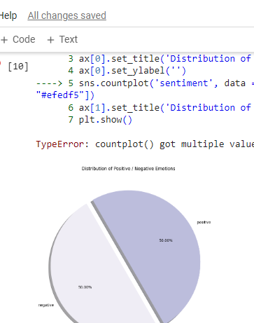
Result
Sentiment
Negative 25000
Positive 25000
50 % negative and 50 % positive

Slide 10
CONSLUSION
We utilized a movie dataset for binary sentiment classification, which notably exceeded the scale of previous benchmark datasets. Our dataset comprised 25,000 highly polar movie reviews for both training and testing purposes. By employing classification or deep learning algorithms, we successfully predicted the number of positive and negative reviews, achieving significant advancements in sentiment analysis for movie reviews.

Slide 11
Future scope
Handling Imbalanced Data
Model Improvement and Tuning
Transfer Learning and Pretrained Models
Multi-Modal Analysis

Slide 12
REFERENCES
1. Maas, A. L., Daly, R. E., Pham, P. T., Huang, D., Ng, A. Y., & Potts, C. (2011). Learning Word Vectors for Sentiment Analysis. In Proceedings of the 49th Annual Meeting of the Association for Computational Linguistics: Human Language Technologies.
2. Pang, B., & Lee, L. (2004). A Sentimental Education: Sentiment Analysis Using Subjectivity Summarization Based on Minimum Cuts. In Proceedings of the 42nd Annual Meeting of the Association for Computational Linguistics (ACL'04).
3. Bo Pang and Lillian Lee. (2005). Seeing stars: Exploiting class relationships for sentiment categorization with respect to rating scales. In Proceedings of the 43rd Annual Meeting of the Association for Computational Linguistics (ACL'05).

Slide 13
THANK YOU

